Slide 1



Cloud Computing Project Proposal
Image Classification
Group 10
Madison Raasch, Jianfei Shi, Fei Wu

Slide 2


Background & Business Problem
Image classification is a pivotal task in computer vision that involves categorizing images into predefined classes
A cloud-based image classification system can provide scalable and efficient solutions on this purpose
Leveraging AWS services, our objective is to develop a cloud-based image classification system (to reduce operation costs…)

Slide 3
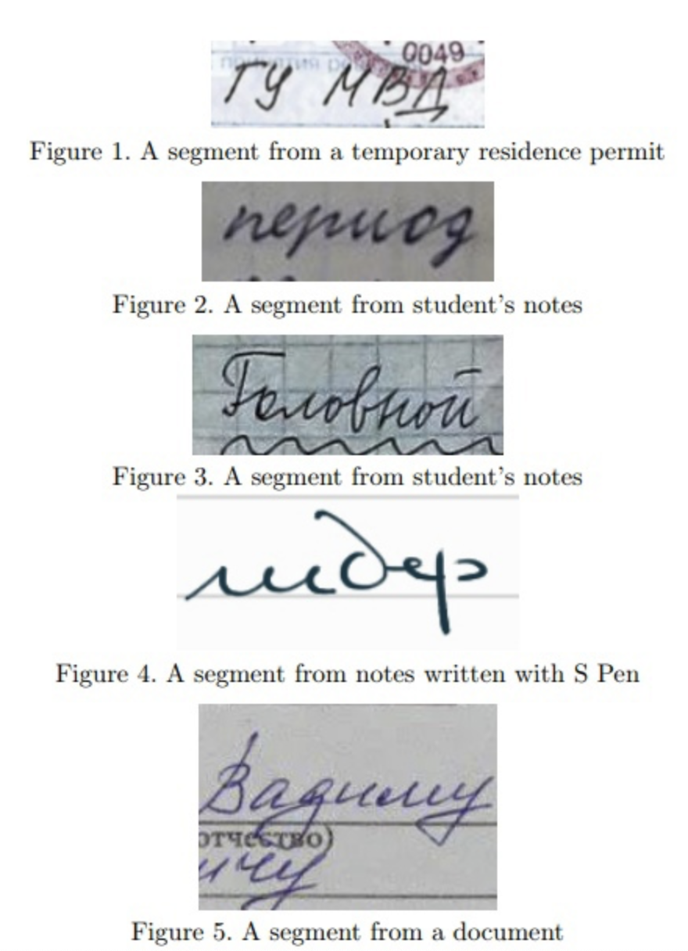

Data Procurement
Cyrillic Handwriting Dataset
Composed of 73830 segments of handwriting texts (crops) in Russian and splited into train, and test sets with a split of 95%, 5%, respectively
Each crop is an image of an expression in Russian of no more than 40 symbols written by hand

Slide 4










System Design
Data Storage
Amazon S3
User
Amazon API gateway
SageMaker
notebook
model
Amazon S3
SageMaker endpoint
AWS Lambda

Slide 5

Major Technologies
S3 Standard
SageMaker
API gateway
SageMaker
Amazon Lambda
It is suitable for storing image data.
The model may be accessed frequently with low latency.
Storage can be scaled up or down seamlessly.
It is suitable for training, evaluating the proposed image classification model and make predictions.
IAM role for access data in S3 bucket
Cost-effective.
Serverless, no need to configure infrastructure.
IAM role for access SageMaker endpoint
Direct integration with Lambda that handles user request for image classification tasks.
Member Responsibility
Madison: Setup S3 storage, load data into bucket, write lambda function that preprocesses new image data from user.
Jianfei: Setup Amazon Lambda that connects to SageMaker endpoint, and API gateway for user connection.
Fei: Setup SageMaker, write jupyter notebook for modeling and evaluation, save model to S3, set up endpoint.

Slide 6

Milestones
April 4th
April 8th
April 14th
April 19th
Load Data
Model Training
Model Interface
API
Load data into the cloud using S3
Model training and evaluation with Sagemaker
Create programmatic model interface with Lambda
Create Amazon API gateway for handling requests

Slide 7
Milestones
Apri
April
23rd
April
27th
April 19th
User Interface
Integration
Implement a simple web application with AWS Flask and deploy it with AWS Lambda
Integrate Flask application with deployed model and test interface.

Slide 8

THANK'S FOR WATCHING

